Slide 1
FUND OUR SAFETY NET:
FIX ICP ALLOCATION!
Action Toolkit for Spurring Change
NY Docs Coalition

Slide 2
Inequitable Funding Results in Differences in COVID-19 Mortality Rates
Notes:
Article by NYT detailing how covid exacerbated inequalities in the NYC health systems
Public safety net hospitals are underfunded and therefore unable to provide as good care
Data is not accessible to the public--speculated because it highlights these inequalities
Add a heading making clear result of misallocation
https://www.nytimes.com/2020/07/01/nyregion/Coronavirus-hospitals.html?auth=login-email&login=email

Slide 3
What is the Indigent Care Pool (ICP)?
Pool of money to help hospitals offset the cost of caring for Medicaid and uninsured patients
Distributes ~$1.2 billion per year
ICP has been part of the Disproportionate Share Hospital (DSH) program since it was created in 1996
DSH funding is supposed to go to safety net hospitals

Slide 4
Safety Net Hospitals
Meet any of the Three Criteria:
Any private hospital that meets all of the following criteria
50% or more of all patients treated (inpatient and outpatient) receive Medicaid or are medically uninsured; and
40% or more of inpatient discharges are covered by Medicaid; and,
No more than 25% of inpatient discharges are covered by private insurance; and
At least 3% of patients receiving services are uninsured; and
Provides care to uninsured patient in all services, including emergency, hospital based and community clinics, dental and prenatal care.
Any public hospital operated by a county, municipality or public benefit corporation, regardless of its patient population characteristics.
Any hospital that is federally designated as a critical access or sole community provider facility.
Notes:
https://www.nysna.org/key-funding-new-york%E2%80%99s-hospitals#.YC2CrndKhp8
https://codes.findlaw.com/ny/public-health-law/pbh-sect-2807-c.html

Slide 5
DSH Funding is Meant to Only go to Safety Net Hospitals. NY is One of Only Three States that Provides DSH Funding to 90% of its Hospitals.
Notes:
https://www.cssny.org/publications/entry/unintended_consequences

Slide 6
Sample of Hospitals Receiving ICP Funds
Hospital Name | Percent of all Hospital Discharges that are Medicaid and Self-Pay
Bronx Lebanon, Fulton Division | 80%
NYC H+H/Metropolitan | 72%
University Hospital Brooklyn | 49%
Montefiore Medical Center | 45%
Mount Sinai Beth Israel | 38%
New York Presbyterian Hospital | 31%
Winthrop University Hospital | 21%
Memorial Sloan Kettering | 8%
Notes:
https://www.cssny.org/publications/entry/unintended_consequences

Slide 7
ICP Allocation

Slide 8
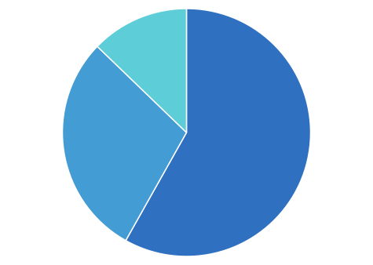
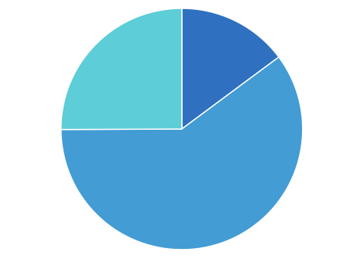
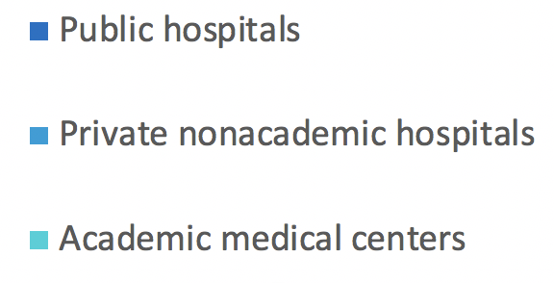
Percent of Total Uninsured Patients
Percent of ICP
13%
15%
25%
29%
58%
60%
Notes:
https://nyshealthfoundation.org/wp-content/uploads/2017/12/examination-of-indigent-care-pool-allocation-march-2017.pdf

Slide 9
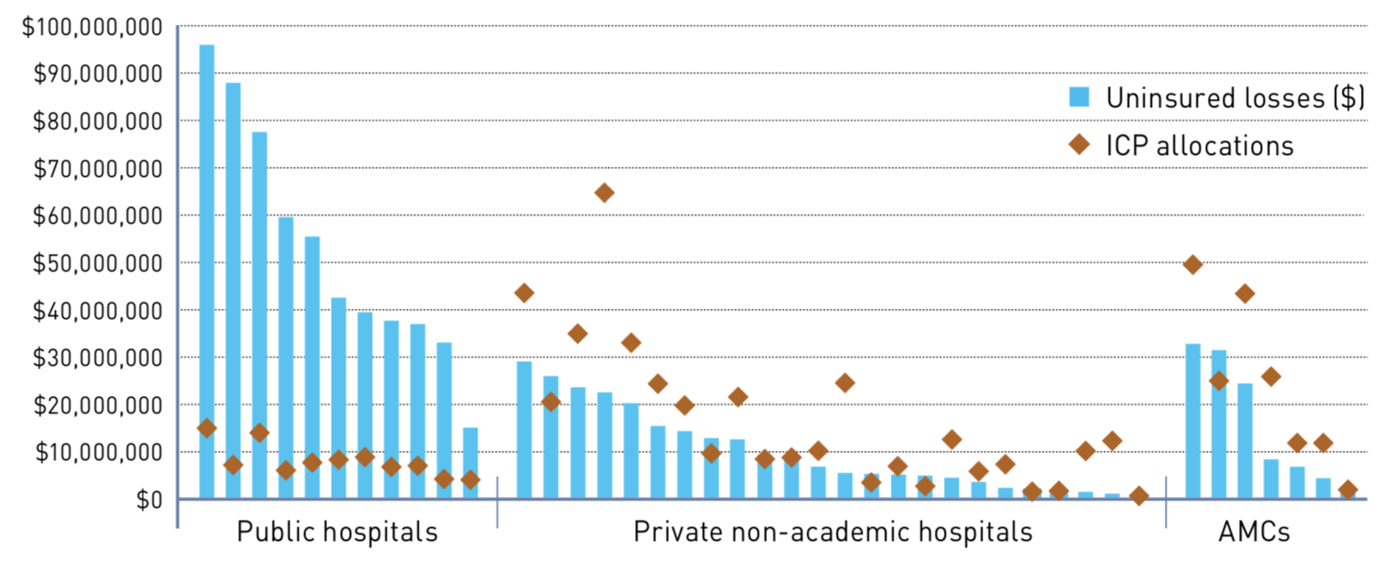
ICP Funding Compared to Uninsured Losses
Notes:
https://nyshealthfoundation.org/wp-content/uploads/2017/12/examination-of-indigent-care-pool-allocation-march-2017.pdf

Slide 10
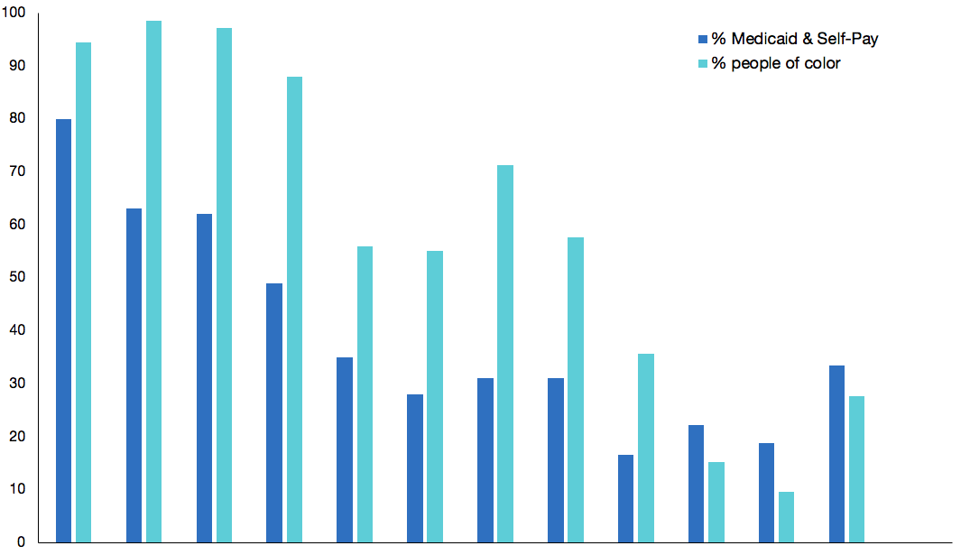
Percent People of Color and Percent Medicaid by Hospital
Safety Net Hospitals
Private Non Academic Hospitals
Academic Medical Centers
Notes:
https://health.data.ny.gov/dataset/Hospital-Inpatient-Discharges-SPARCS-De-Identified/22g3-z7e7
In 2017, a New York report found that Black patients were two to three times less likely than whites to be treated at academic medical centers than other hospitals in New York City. It also found that uninsured patients were about five times less likely than insured patients to be treated at academic medical centers.28
Journal article of AMCs in NYC v. Boston

Slide 11
Percent People of Color and Percent Medicaid by Hospital
University Hospital of Brooklyn
NY-Pres, Columbia
Montefiore New Rochelle
NY-Pres, Cornell
Mount Sinai
NYU Langone
Safety Net Hospitals
Private Non Academic Hospitals
Academic Medical Centers
Notes:
https://health.data.ny.gov/dataset/Hospital-Inpatient-Discharges-SPARCS-De-Identified/22g3-z7e7
In 2017, a New York report found that Black patients were two to three times less likely than whites to be treated at academic medical centers than other hospitals in New York City. It also found that uninsured patients were about five times less likely than insured patients to be treated at academic medical centers.28
Journal article of AMCs in NYC v. Boston

Slide 12
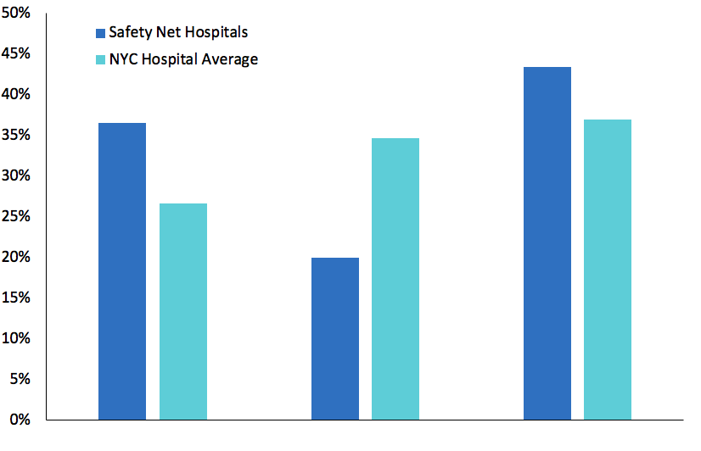
Racial Demographic in Safety Net Hospitals
Black
White
Other
Notes:
Data from 2017 SPARCS compiled by NYSNA
https://www1.nyc.gov/site/doh/data/data-sets/epi-census.page

Slide 13
Why is ICP funding allocation so inequitable?

Slide 14
Why is ICP funding allocated in this way?
Bad debt also included payments that insurance companies refused to pay
Hospitals who claimed more bad debt caused harm by eating up money that should have gone to safety net hospitals
Despite reforms the allocation formula still essentially relies on bad debt
Notes:
Bad debts are defined in Health Department regulations and include amounts charged to patients which remain unpaid and are determined by the hospital to be uncollectible.
Charity care includes amounts hospitals determined not to bill the patient because a determination was made that the patient was medically indigent.
Bad debt is part that pt doesn’t pay/or insurance company doesn’t pay
Source for pic: https://www.patriotsoftware.com/blog/accounting/bad-debt/

Slide 15
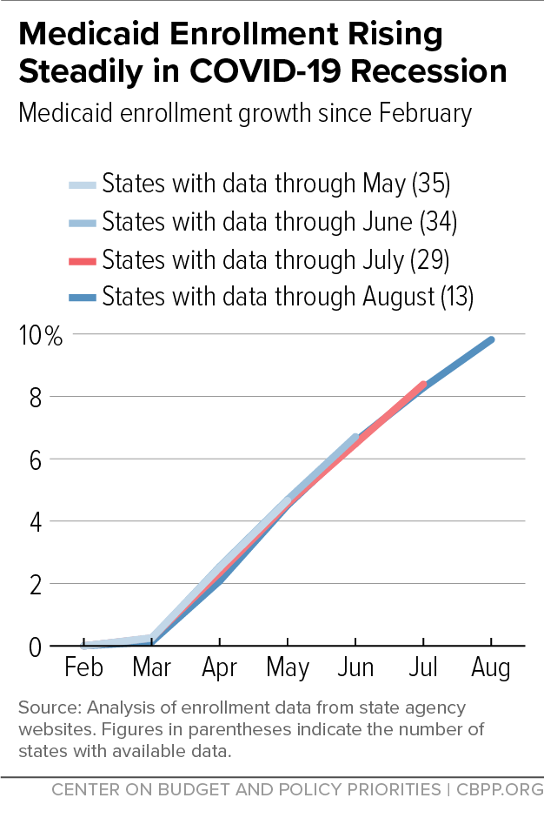
Medicaid Cuts Will Affect Safety Net Hospitals More Than Private Hospitals
Proposed cuts will cause $65 million loss for NYC Health and Hospitals
Cuomo proposed that municipalities pay for losses
State funding for ICP may also be cut
Notes:
https://www.nytimes.com/2020/03/30/nyregion/coronavirus-hospitals-medicaid-budget.html
https://subscriber.politicopro.com/article/2020/02/04/strapped-nyc-health-hospitals-faces-new-funding-threats-from-state-feds-1258809
https://www.cbpp.org/blog/medicaid-enrollment-continues-to-rise
https://www.scribd.com/document/492054818/The-Blue-Book-Senate-Majority-Staff-Analysis-of-the-2021-2022-Executive-Budget-Proposal#download

Slide 16
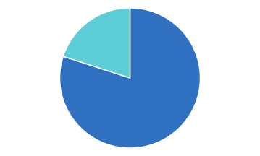
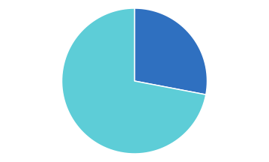
Medicaid Cuts Will Affect Safety Net Hospitals More
% Medicaid Patients
% Medicaid Patients
Bronx Lebanon, Fulton Division
Mount Sinai Hospital

Slide 17
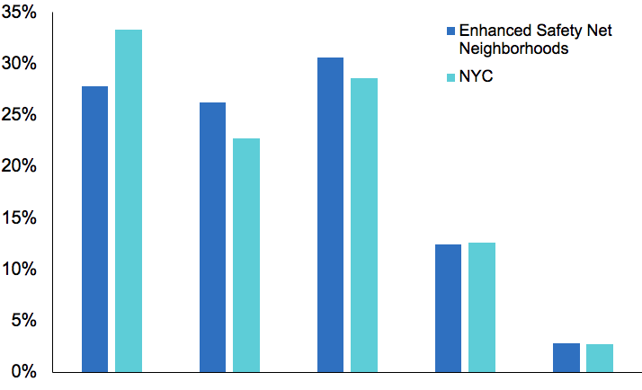
Safety Net Neighborhood Demographics
White, Nonhispanic
Black, Nonhispanic
Hispanic
Asian/Pacific Islander
Other
Notes:
Data from DOHMH neighborhood data 2010 census

Slide 18
Bill S5954/A6883 addresses some of the fiscal drivers of racial inequities in healthcare
Improves equity in payments to focus scarce government resources on the safety net
Allocating $1.1B in disproportionate share funding to Enhanced Safety Net Hospitals and Qualified Safety Net Hospitals
Defining “Qualified Safety Net Hospital” (>45% patients uninsured or receiving medicaid, >36% inpatient discharges medicaid, <28% of its inpatient discharges commercially insured, >2% of care is for uninsured)
Notes:
Assembly bill: https://www.nysenate.gov/legislation/bills/2021/a6883
Senate bill: https://www.nysenate.gov/legislation/bills/2021/s5954

Slide 19
Asking for Mount Sinai to Sign onto Goals to Oppose Medicaid Cuts and Support Restructuring of ICP Funding
Target Indigent Care Pool and Disproportionate Share Hospital (ICP/DSH) funding to Essential Safety Net Hospitals
No Medicaid Cuts to Enhanced Safety Net Hospitals
Medicaid Reimbursement Rates Should be Increased to Support Safety Net Hospitals
Notes:
https://medicaidmattersny.org/wp-content/uploads/2021/01/ICP-statement-2020-2021-Final.pdf

Slide 20
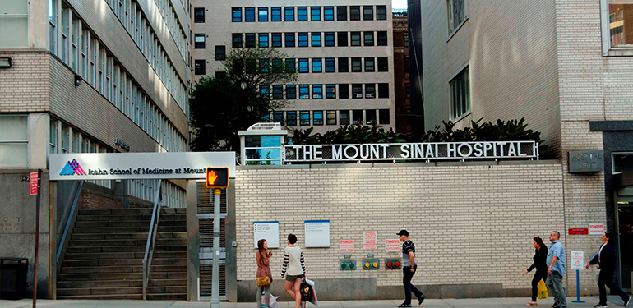
Asking for Mount Sinai to Sign onto Medicaid Matters Goals to Oppose Medicaid Cuts and Support Restructuring of ICP Funding
Mount Sinai has one hospital that qualified as a safety net hospital
Mount Sinai would not actually need to take any actions
Mount Sinai can be a leader for other academic medical centers

Slide 21
Our moment to lead academic health centers
Private, non-profit academic health centers can have a large voice in more equitable government financing
We can influence lobbying groups like the Greater NY Hospital Association
Our trainees and students deeply care about this -- equity is fundamental to our competitiveness for talent and preserving the “soul of medicine” for future doctors

Slide 23
Actions!

Slide 24
#1 Sign Petition Endorsed by ...
...And More!
Notes:
https://docs.google.com/forms/d/e/1FAIpQLScq5_rvSWOIgZ5HRTvwnO1dPPJLyAbEbQsERA7pZwXh7mZxVw/viewform

Slide 25
#2 Sign Mount Sinai Specific Petition
...And More!
Notes:
https://forms.gle/AVwbfjyHxbqkCTWg6

Slide 26
#3 Submit Statements
Notes:
https://forms.gle/dVYSiMgAE8GuiEcQ8

Slide 27
#4 Share on Social Media
@icp_initiative
@icp_initiative

Slide 28
Acknowledgements
Dr. Duncan Maru
Dr. Betty Kolod
Dr. Jenny Hua
Judy Wesseler
Student Acknowledgements
Emily Xu, Paige Cloonan, Julie Byrnes, and Remi Schneider

Slide 29
Safety Net Hospitals
Hospital Name | Percent Medicaid and Self-Pay Discharges | 3 Year Total Windfall
Bronx-Lebanon, Fulton Division | 80% | -$5,383,048
Interfaith | 78% | $5,137,264
Woodhull | 73% | -$10,507,984
Metropolitan | 72% | -$1,109,042
Harlem | 67% | $4,764,910
Kings County | 66% | -$12,060,846
Queens Hospital center | 66% | -$13,775,563
St. Barnabas | 66% | $2,970,214
Lincoln | 65% | -$77,996
North Central Bronx | 64% | $767,698
Notes:
https://www.cssny.org/publications/entry/unintended_consequences
https://nyshealthfoundation.org/wp-content/uploads/2017/12/examination-of-indigent-care-pool-allocation-march-2017.pdf

Slide 30
Safety Net Hospitals (continued)
Hospital Name | Percent Medicaid and Self-Pay Discharges | 3 Year Total Windfall
Elmhurst | 63% | -$22,934,177
Bronx Lebanon, Concourse Division | 63%
Jacobi | 62% | -$409,055
Bellevue | 62% | -$8,083,009
NY Eye and Ear Infirmary | 55% | $3,497,782
Coney Island | 54% | -$11,809,769
Flushing | 54% | -$12,274,090
Brookdale | 52% | $29,102,060
Jamaica | 52% | $19,988,227
NY-Presbyterian, Allen Hospital | 51%
Notes:
https://www.cssny.org/publications/entry/unintended_consequences
https://nyshealthfoundation.org/wp-content/uploads/2017/12/examination-of-indigent-care-pool-allocation-march-2017.pdf

Slide 31
References
A Report on the Hospital Indigent Care Pool. (n.d.). Retrieved January 28, 2021, from https://www.health.ny.gov/facilities/hospital/indigent_care/2008_indigent_care_report.htm#background_a
Brian M. Rosenthal, Joseph Goldstein, Sharon Otterman, & Sheri Fink. (2020, July 1). Why Surviving Covid Might Come Down to Which NYC Hospital Admits You—The New York Times. https://www.nytimes.com/2020/07/01/nyregion/Coronavirus-hospitals.html
Carrie Tracy, JD, Elisabeth R. Benjamin, MSPH, JD, & Amanda Dunker, MPP. (2018). Unintended Consequences—How New York State patients and safety-net hospitals are short changed. https://www.cssny.org/publications/entry/unintended_consequences
Hooked on HCRA: New York’s 24-Year Health Tax Habit. (2020, March 11). Empire Center for Public Policy. https://www.empirecenter.org/publications/hooked-on-hcra-new-yorks-24-year-health-tax-habit/
How New York’s ‘indigent’ health aid goes to the rich. (n.d.). Retrieved January 28, 2021, from https://nypost.com/2017/09/21/how-new-yorks-indigent-health-aid-goes-to-the-rich/
Icahn School of Medicine at Mount Sinai—Pediatric clinic. (n.d.). PKD Foundation. Retrieved February 4, 2021, from http://pkdcure.org/medical_center/icahn-school-of-medicine-at-mount-sinai-2/
Medicaid Enrollment Continues to Rise. (2020, September 9). Center on Budget and Policy Priorities. https://www.cbpp.org/blog/medicaid-enrollment-continues-to-rise
Medicaid Matters. (n.d.). ICP-statement-2020-2021-Final.pdf. Retrieved February 4, 2021, from https://medicaidmattersny.org/wp-content/uploads/2021/01/ICP-statement-2020-2021-Final.pdf
New York State Indigent Care Pool Workgroup Report. (n.d.). 12.
N.Y. Hospitals Face $400 Million in Cuts Even as Virus Battle Rages—The New York Times. (n.d.). Retrieved February 4, 2021, from https://www.nytimes.com/2020/03/30/nyregion/coronavirus-hospitals-medicaid-budget.html
Roosa Tikkanen, M.P.H., M.Res, Steffie Woodhandler, M.D., M.P.H., & David Himmelstein, M.D. (2017). An Examination of Indigent Care Pool Allocation. https://nyshealthfoundation.org/wp-content/uploads/2017/12/examination-of-indigent-care-pool-allocation-march-2017.pdf
What Small Business Owners Need to Know About Bad Debt. (2018, April 24). Patriot Software. https://www.patriotsoftware.com/blog/accounting/bad-debt/

